Slide 1
Network Layer: Logical Addressing
19.1
Copyright © The McGraw-Hill Companies, Inc. Permission required for reproduction or display.

Slide 2
19-1 IPv4ADDRESSES
An IPv4 address is a 32-bit address that uniquely and universally defines the connection of a device (for example, a computer or a router) to the Internet.
Address Space Notations
Classful Addressing Classless Addressing
Network Address Translation (NAT)
19.2

Slide 3

Note
An IPv4 address is 32 bits long.
19.3

Slide 4
Note
The IPv4 addresses are unique and universal.
19.4

Slide 5
Note
The address space of IPv4 is
₂32
or 4,294,967,296.
19.5

Slide 6
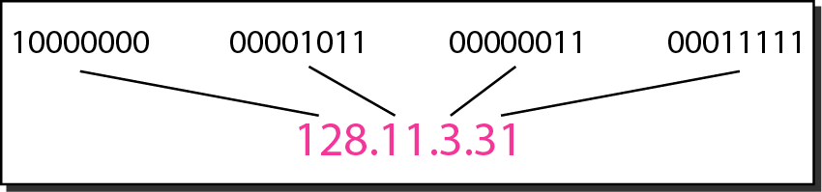
Figure 19.1 Dotted-decimal notation and binary notation for an IPv4 address
19.6

Slide 7
Note
Numbering systems are reviewed in Appendix B.
19.7

Slide 8
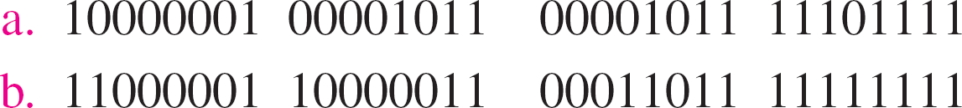
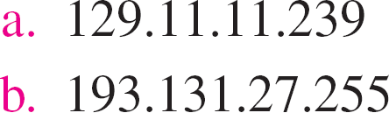
Example 19.1
Change the following IPv4 addresses from binary notation to dotted-decimal notation.
Solution
We replace each group of 8 bits with its equivalent decimal number (see Appendix B) and add dots for separation.
19.8

Slide 9
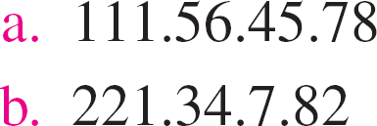
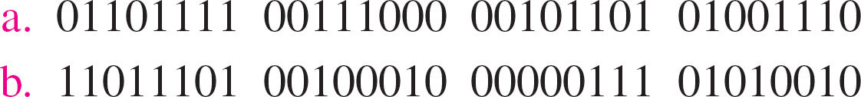
Example 19.2
Change the following IPv4 addresses from dotted-decimal notation to binary notation.
Solution
We replace each decimal number with its binary equivalent (see Appendix B).
19.9

Slide 10
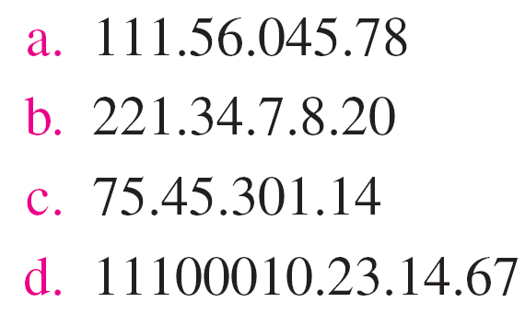
Example 19.3
Find the error, if any, in the following IPv4 addresses.
Solution
There must be no leading zero (045).
There can be no more than four numbers.
Each number needs to be less than or equal to 255.
A mixture of binary notation and dotted-decimal notation is not allowed.
19.10

Slide 11
Note
In classful addressing, the address space is divided into five classes: A, B, C, D, and E.
19.11

Slide 12
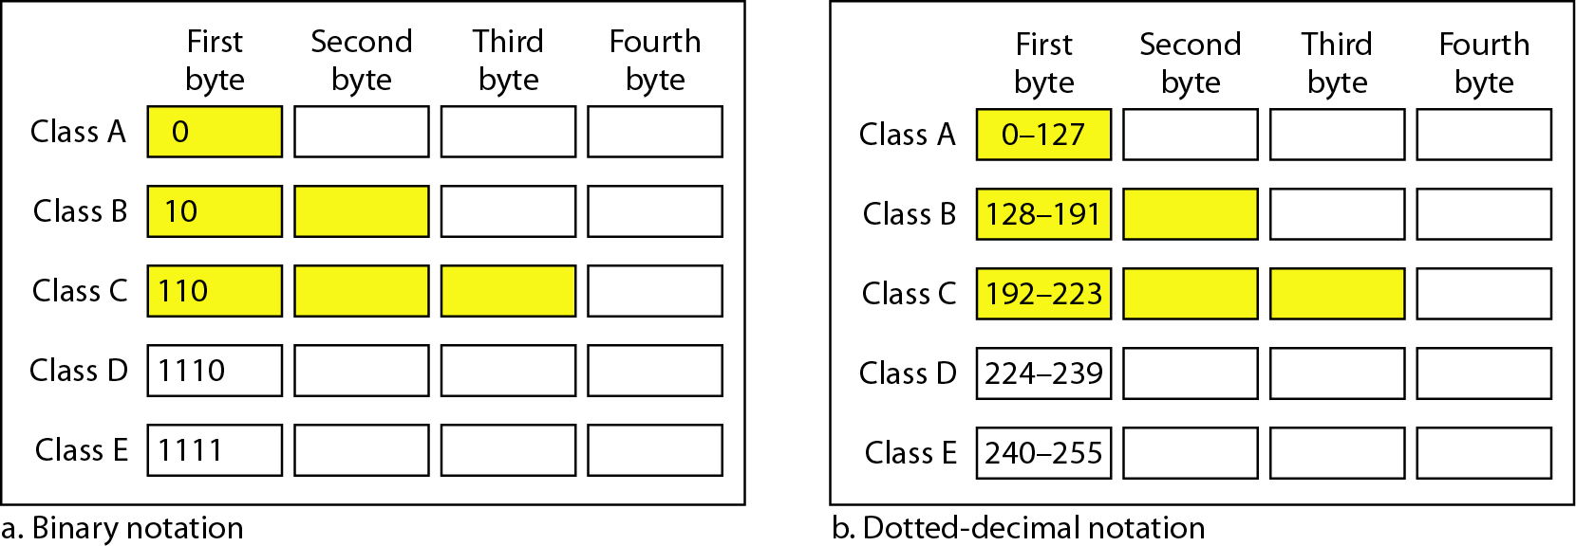
Figure 19.2 Finding the classes in binary and dotted-decimal notation
19.12

Slide 13
Example 19.4
Find the class of each address.
a. 00000001 00001011 00001011 11101111
b. 11000001 10000011 00011011 11111111
c. 14.23.120.8
d. 252.5.15.111
Solution
The first bit is 0. This is a class A address.
The first 2 bits are 1; the third bit is 0. This is a class C address.
The first byte is 14; the class is A.
The first byte is 252; the class is E.
19.13

Slide 14
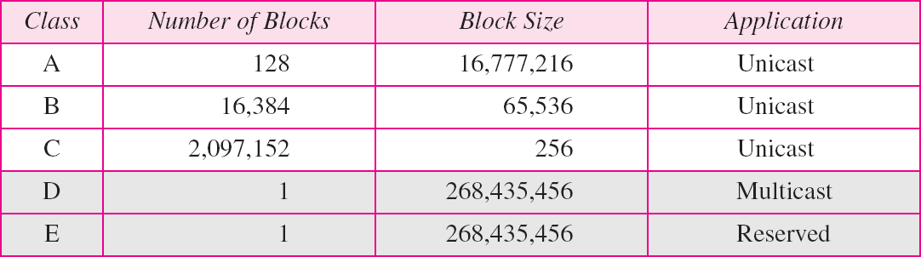
Table 19.1 Number of blocks and block size in classful IPv4 addressing
19.14

Slide 15
Note
In classful addressing, a large part of the available addresses were wasted.
19.15

Slide 16
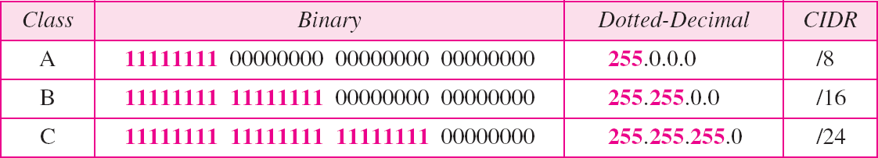
Table 19.2 Default masks for classful addressing
19.16

Slide 17
Note
Classful addressing, which is almost obsolete, is replaced with classless addressing.
19.17

Slide 18
Example 19.5
Figure 19.3 shows a block of addresses, in both binary and dotted-decimal notation, granted to a small business that needs 16 addresses.
We can see that the restrictions are applied to this block. The addresses are contiguous. The number of addresses is a power of 2 (16 = 2⁴), and the first address is divisible by 16. The first address, when converted to a decimal number, is 3,440,387,360, which when divided by 16 results in 215,024,210.
19.18

Slide 19
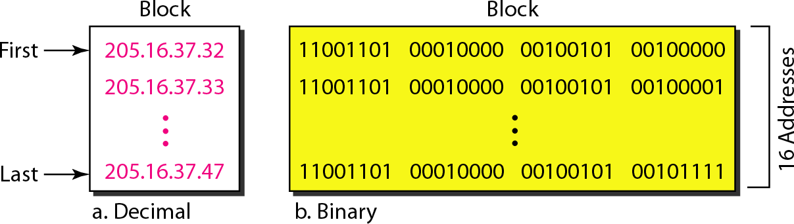
Figure 19.3 A block of 16 addresses granted to a small organization
19.19

Slide 20
Note
In IPv4 addressing, a block of addresses can be defined as
x.y.z.t /n
in which x.y.z.t defines one of the addresses and the /n defines the mask.
19.20

Slide 21
Note
The first address in the block can be found by setting the rightmost
32 − n bits to 0s.
19.21

Slide 22
Example 19.6
A block of addresses is granted to a small organization. We know that one of the addresses is 205.16.37.39/28. What is the first address in the block?
Solution
The binary representation of the given address is 11001101 00010000 00100101 00100111
If we set 32−28 rightmost bits to 0, we get 11001101 00010000 00100101 0010000
or 205.16.37.32.
This is actually the block shown in Figure 19.3.
19.22

Slide 23
Note
The last address in the block can be found by setting the rightmost
32 − n bits to 1s.
19.23

Slide 24
Example 19.7
Find the last address for the block in Example 19.6.
Solution
The binary representation of the given address is 11001101 00010000 00100101 00100111
If we set 32 − 28 rightmost bits to 1, we get 11001101 00010000 00100101 00101111
or 205.16.37.47
This is actually the block shown in Figure 19.3.
19.24

Slide 25
Note
The number of addresses in the block
can be found by using the formula ₂32−n.
19.25

Slide 26
Example 19.8
Find the number of addresses in Example 19.6.
Solution
The value of n is 28, of addresses is 2 ³²⁻²⁸ or 16.
which
means
that
number
19.26

Slide 27
Example 19.9
Another way to find the first address, the last address, and the number of addresses is to represent the mask as a 32- bit binary (or 8-digit hexadecimal) number. This is particularly useful when we are writing a program to find these pieces of information. In Example 19.5 the /28 can be represented as
11111111 11111111 11111111 11110000
(twenty-eight 1s and four 0s).
Find
The first address
The last address
The number of addresses.
19.27

Slide 28
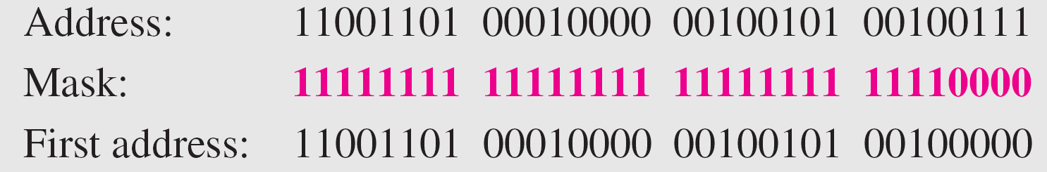
Example 19.9 (continued)
Solution
a. The first address can be found by ANDing the given addresses with the mask. ANDing here is done bit by bit. The result of ANDing 2 bits is 1 if both bits are 1s; the result is 0 otherwise.
19.28

Slide 29
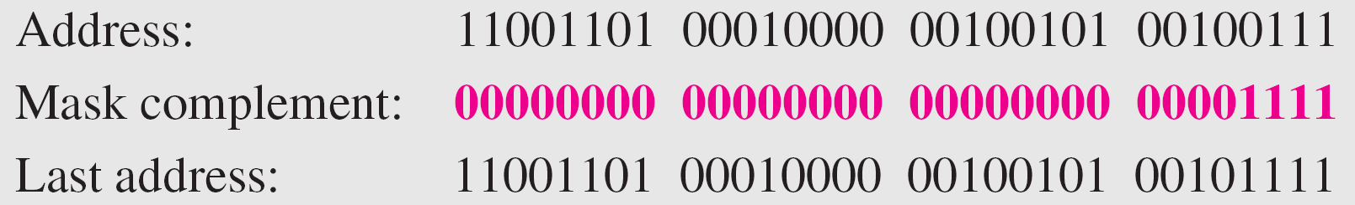
Example 19.9 (continued)
b. The last address can be found by ORing the given addresses with the complement of the mask. ORing here is done bit by bit. The result of ORing 2 bits is 0 if both bits are 0s; the result is 1 otherwise. The complement of a number is found by changing each 1
to 0 and each 0 to 1.
19.29

Slide 30
Example 19.9 (continued)
c. The number of addresses can be found by complementing the mask, interpreting it as a decimal number, and adding 1 to it.
19.30

Slide 31
Figure 19.4 A network configuration for the block 205.16.37.32/28
19.31

Slide 32
Note
The first address in a block is normally not assigned to any device; it is used as the network address that represents the organization
to the rest of the world.
19.32

Slide 33
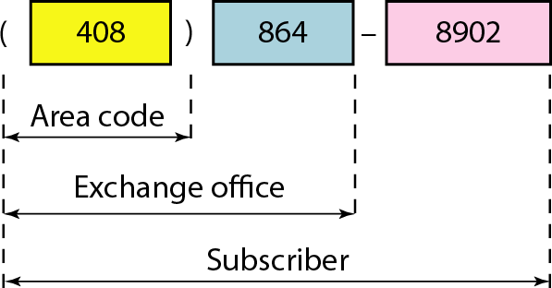
Figure 19.5 Two levels of hierarchy in an IPv4 address
19.33

Slide 34
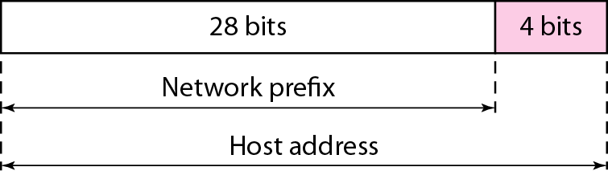
Figure 19.6 A frame in a character-oriented protocol
19.34

Slide 35
Note
Each address in the block can be considered as a two-level hierarchical structure:
the leftmost n bits (prefix) define the network;
the rightmost 32 − n bits define the host.
19.35

Slide 36
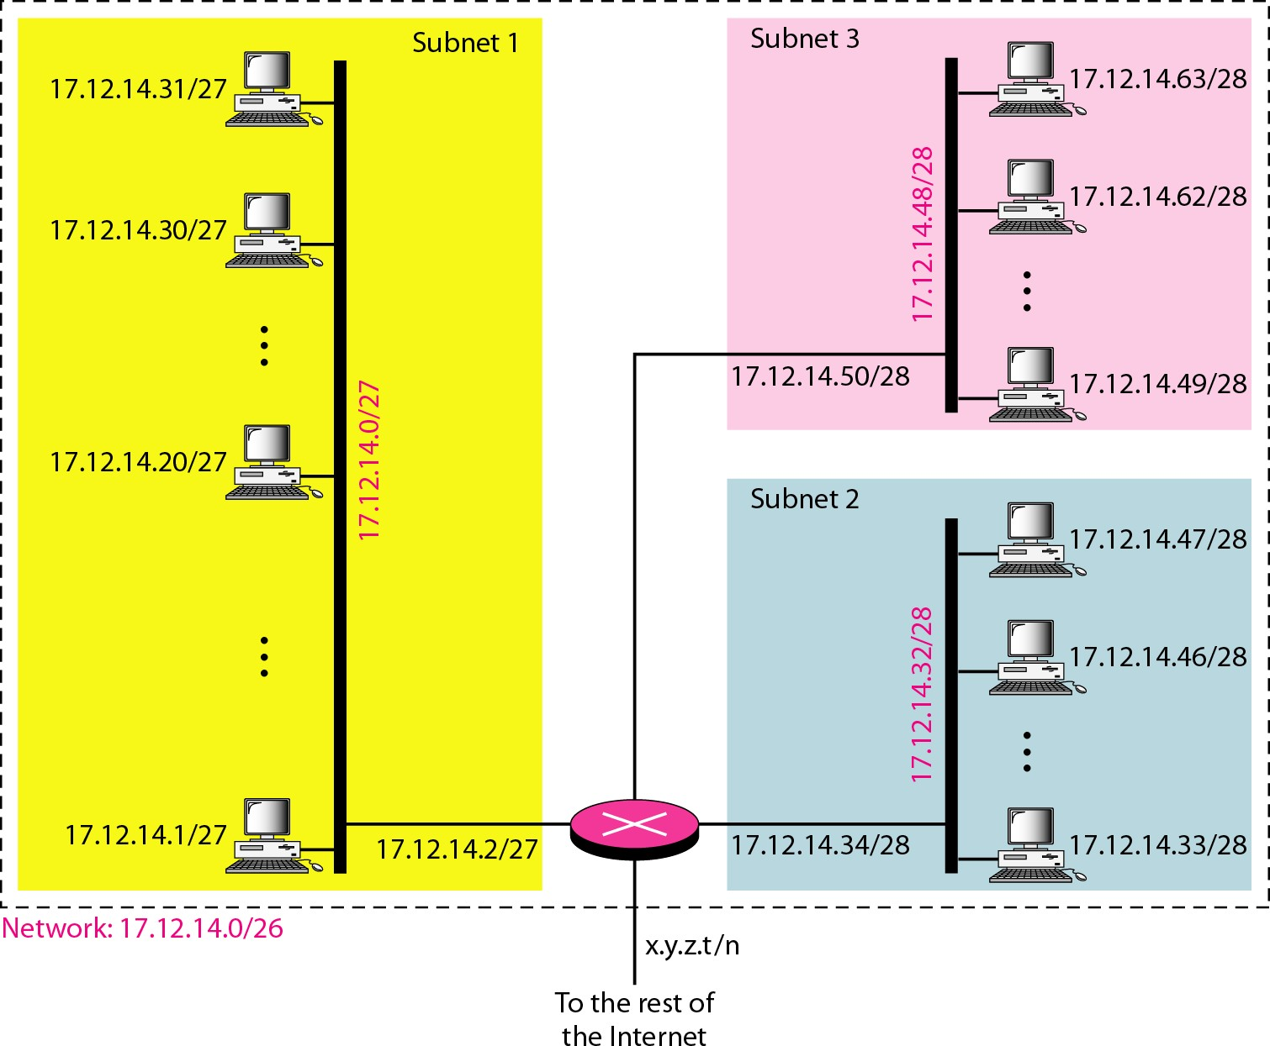
Figure 19.7 Configuration and addresses in a subnetted network
19.36

Slide 37
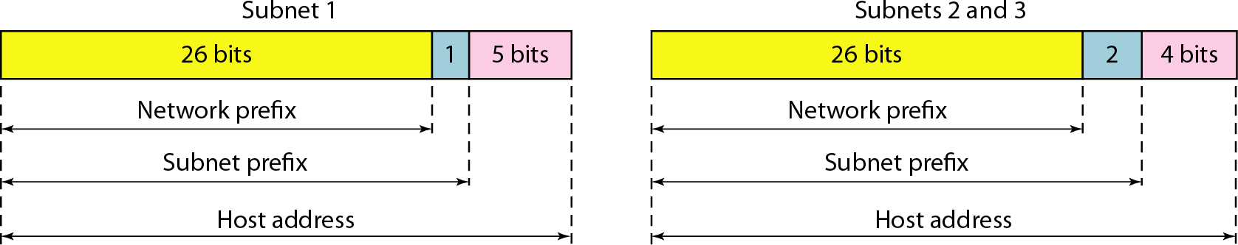
Figure 19.8 Three-level hierarchy in an IPv4 address
19.37

Slide 38
Example 19.10
An ISP is granted a block of addresses starting with 190.100.0.0/16 (65,536 addresses). The ISP needs to distribute these addresses to three groups of customers as follows:
The first group has 64 customers; each needs 256 addresses.
The second group has 128 customers; each needs 128 addresses.
The third group has 128 customers; each needs 64 addresses.
Design the subblocks and find out how many addresses are still available after these allocations.
19.38

Slide 39
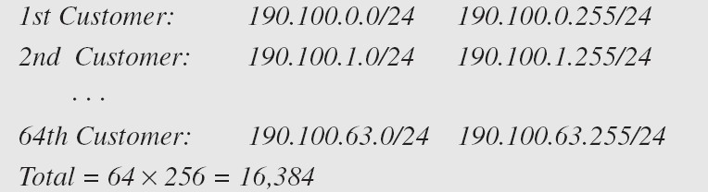
Example 19.10 (continued)
Solution
Figure 19.9 shows the situation.
Group 1
For this group, each customer needs 256 addresses. This means that 8 (log2 256) bits are needed to define each host. The prefix length is then 32 − 8 = 24. The addresses are
19.39

Slide 40
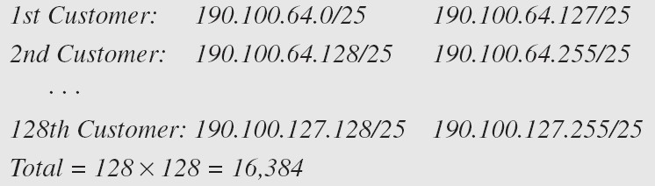
Example 19.10 (continued)
Group 2
For this group, each customer needs 128 addresses. This means that 7 (log2 128) bits are needed to define each host. The prefix length is then 32 − 7 = 25. The addresses are
19.40

Slide 41
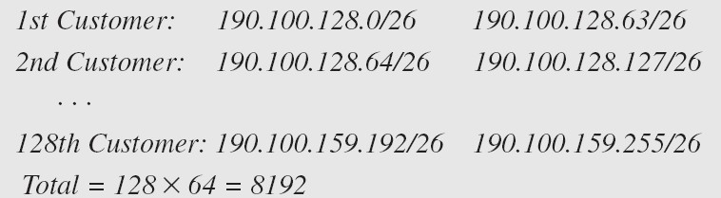
Example 19.10 (continued)
Group 3
For this group, each customer needs 64 addresses. This means that 6 (log₂64) bits are needed to each host. The
prefix length is then 32 − 6 = 26. The addresses are
Number of granted addresses to the ISP: 65,536 Number of allocated addresses by the ISP: 40,960 Number of available addresses: 24,576
19.41

Slide 42
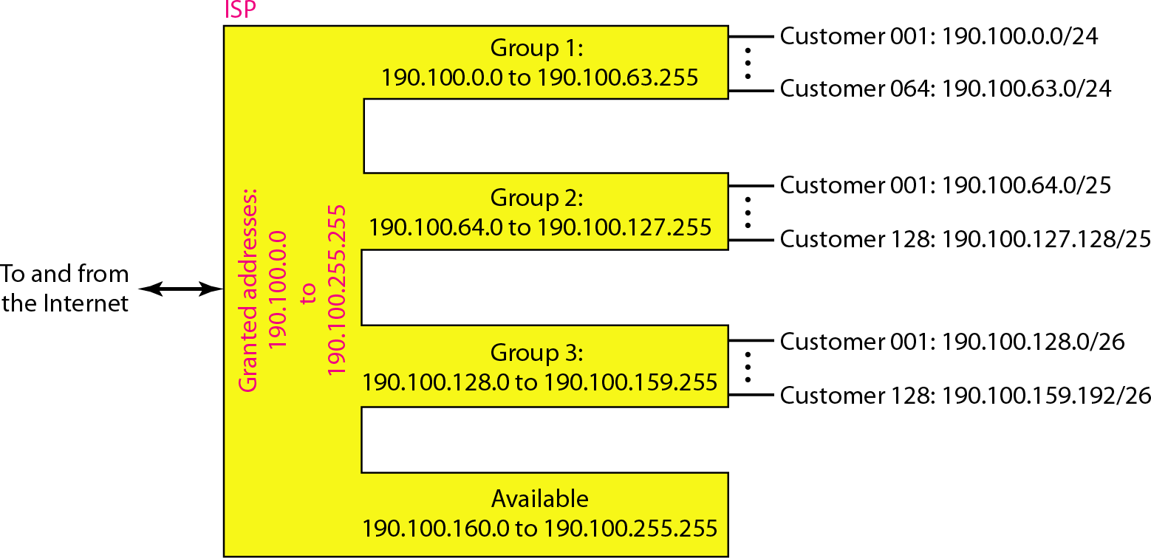
Figure 19.9 An example of address allocation and distribution by an ISP
19.42

Slide 43
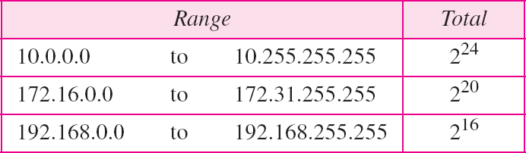
Table 19.3 Addresses for private networks
19.43

Slide 44
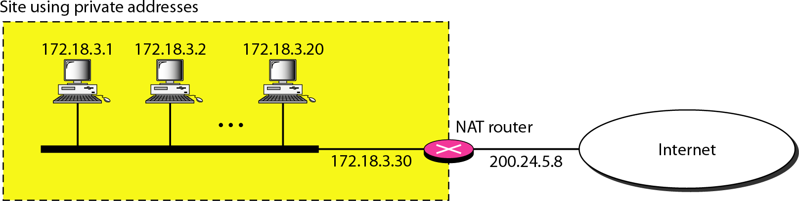
Figure 19.10 A NAT implementation
19.44

Slide 45
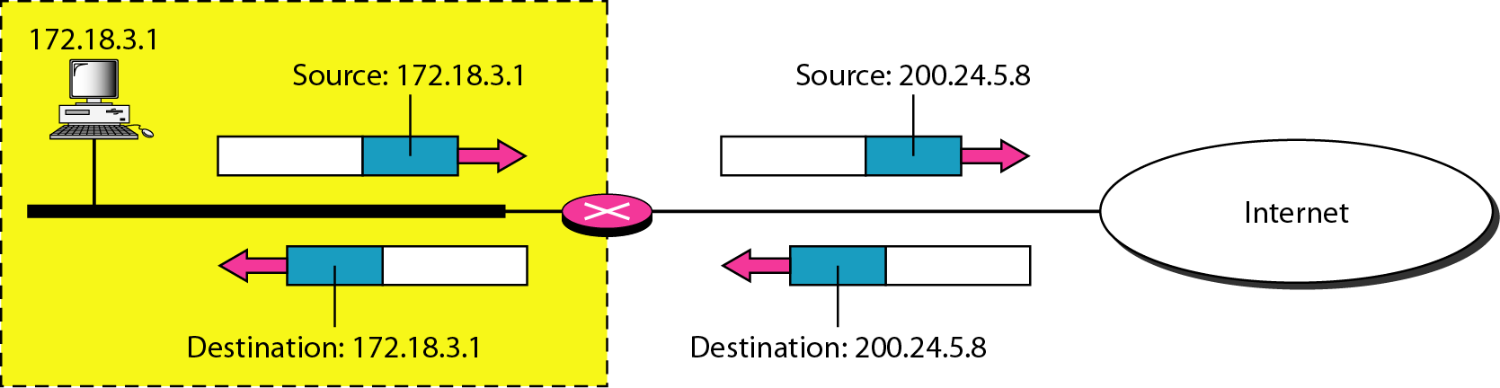
Figure 19.11 Addresses in a NAT
19.45

Slide 46
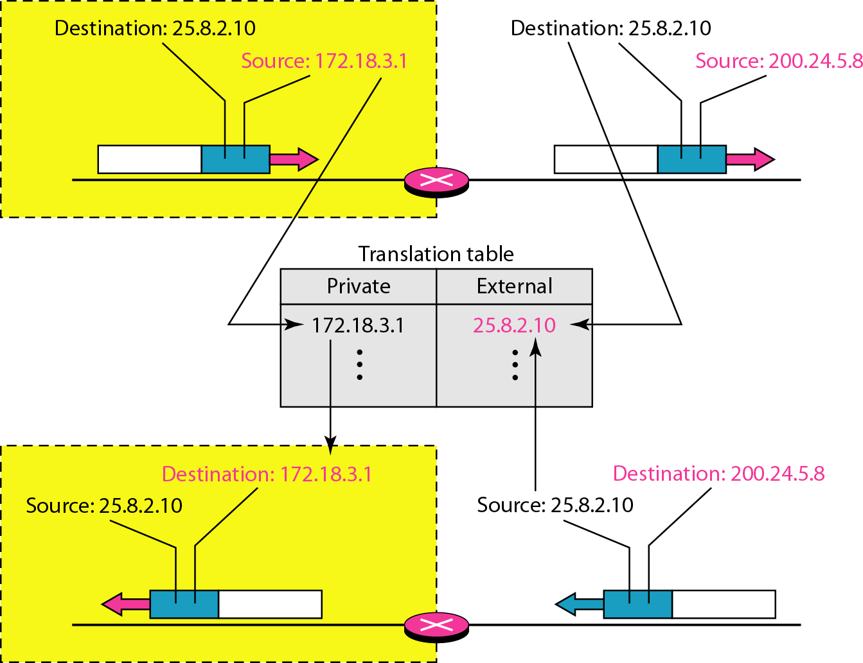
Figure 19.12 NAT address translation
19.46

Slide 47
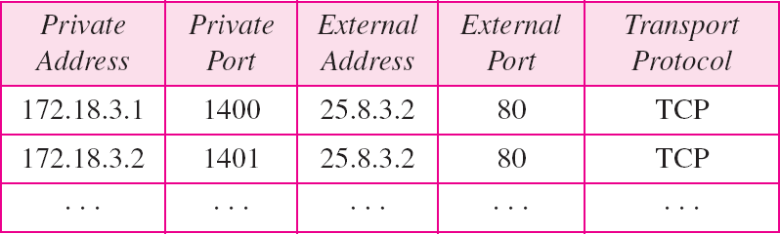
Table 19.4 Five-column translation table
19.47

Slide 48
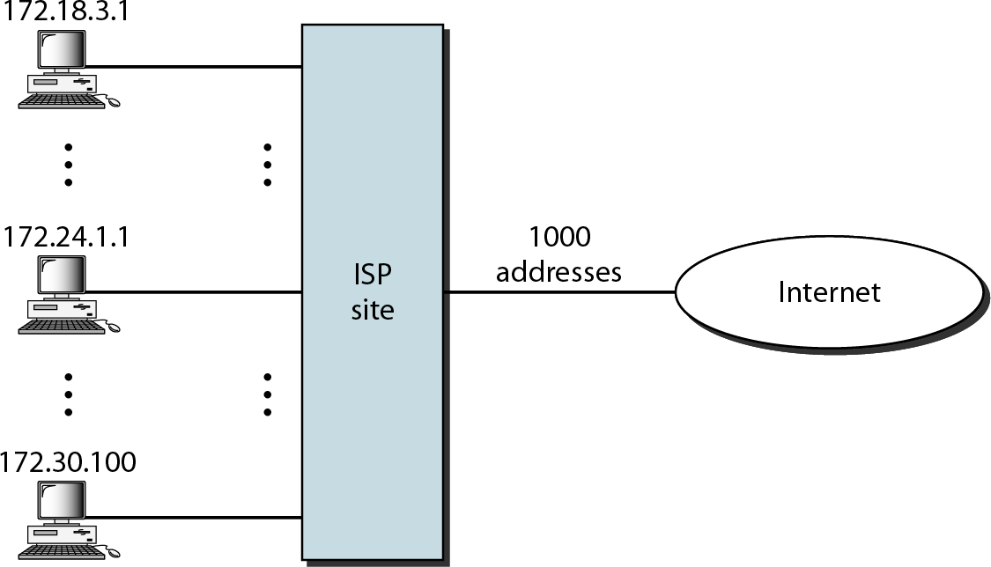
Figure 19.13 An ISP and NAT
19.48

Slide 49
19-2 IPv6ADDRESSES
Despite all short-term solutions, address depletion is still a long-term problem for the Internet. This and other problems in the IP protocol itself have been the motivation for IPv6.
Topics discussed in this section:
Structure Address Space
19.49

Slide 50
Note
An IPv6 address is 128 bits long.
19.50

Slide 51
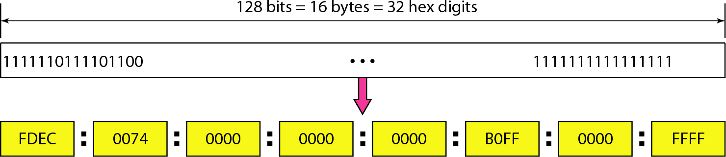
Figure 19.14 IPv6 address in binary and hexadecimal colon notation
19.51

Slide 52
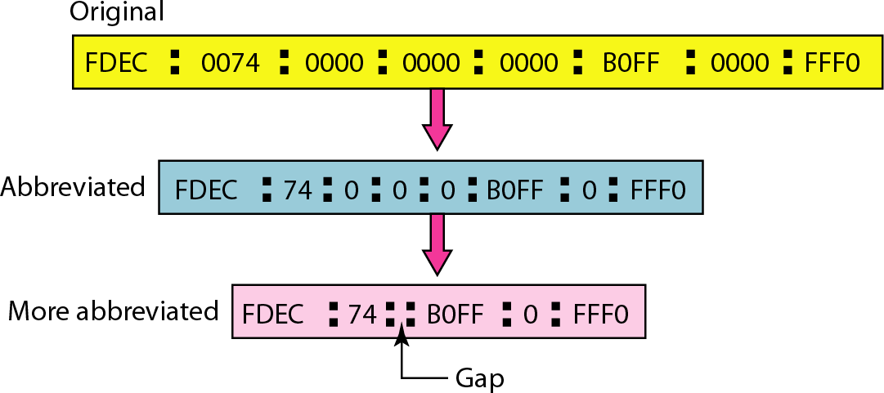
Figure 19.15 Abbreviated IPv6 addresses
19.52

Slide 53
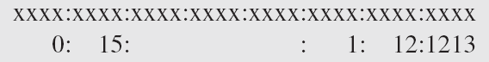
Example 19.11
Expand the address 0:15::1:12:1213 to its original.
Solution
We first need to align the left side of the double colon to the left of the original pattern and the right side of the double colon to the right of the original pattern to find how many 0s we need to replace the double colon.
This means that the original address is.
19.53

Slide 54
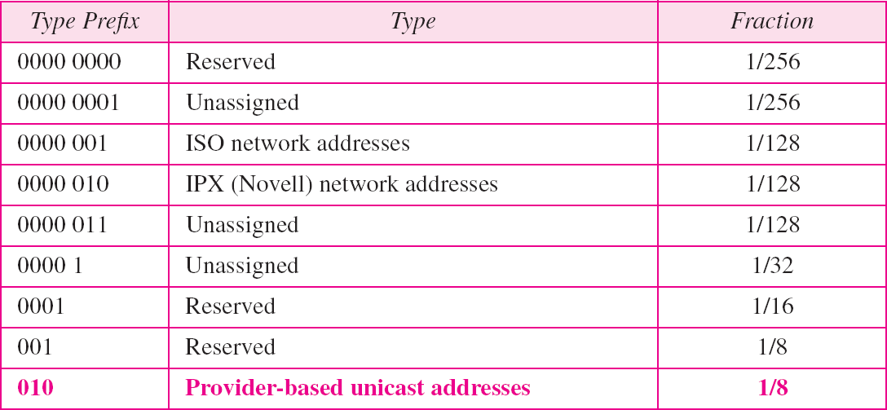
Table 19.5 Type prefixes for IPv6 addresses
19.54

Slide 55
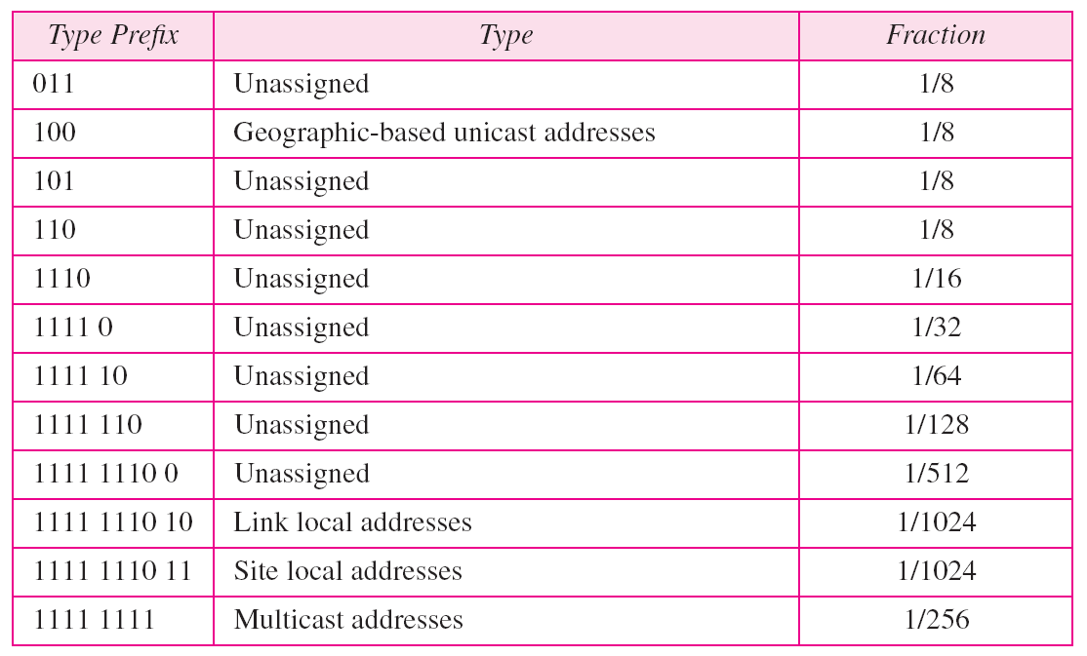
Table 19.5 Type prefixes for IPv6 addresses (continued)
19.55

Slide 56
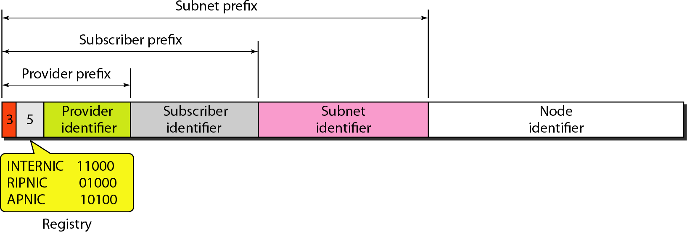
Figure 19.16 Prefixes for provider-based unicast address
19.56

Slide 57
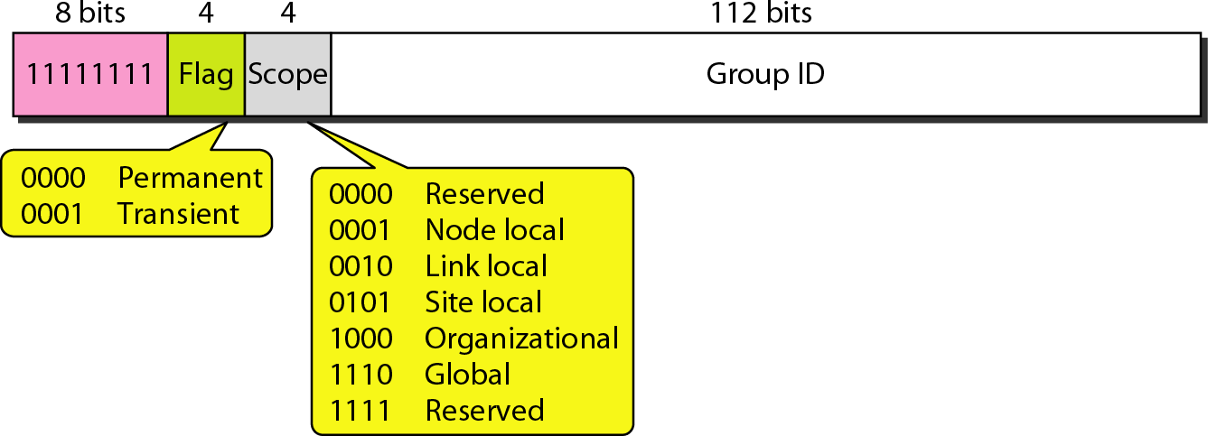
Figure 19.17 Multicast address in IPv6
19.57

Slide 58
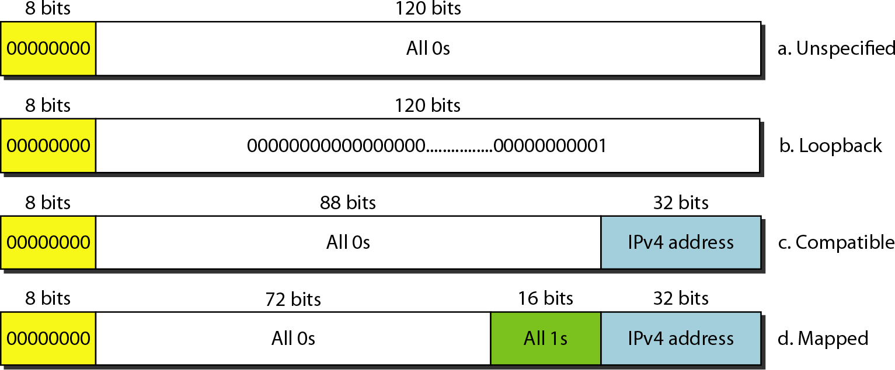
Figure 19.18
Reserved addresses in IPv6
19.58

Slide 59
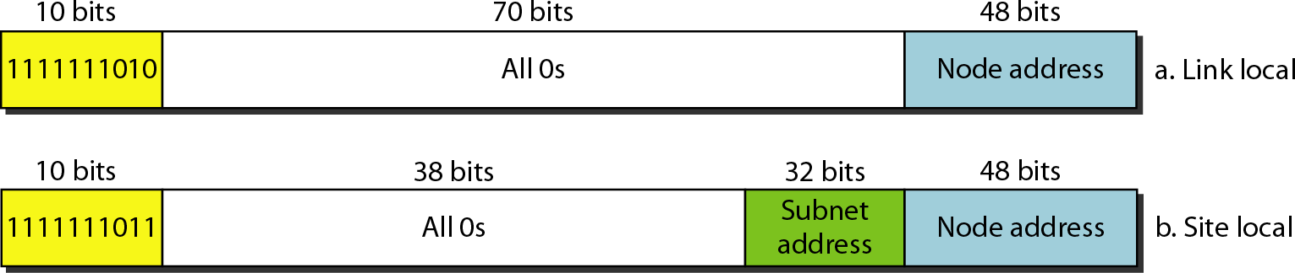
Figure 19.19 Local addresses in IPv6
19.59

Slide 60
Network Layer: Internet Protocol
20.1

Slide 61
20-1 INTERNETWORKING
In this section, we discuss internetworking, connecting networks together to make an internetwork or an internet.
Topics discussed in this section:
Need for Network Layer Internet as a Datagram Network
Internet as a Connectionless Network
20.2

Slide 62
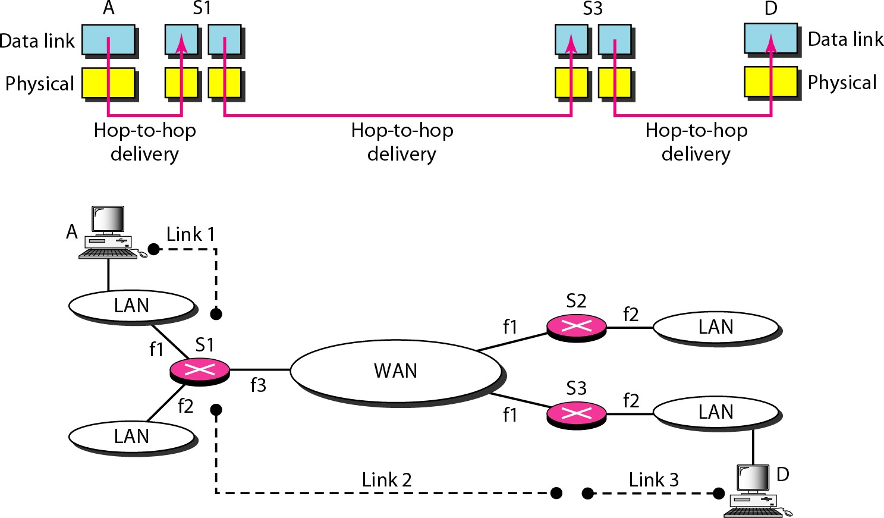
Figure 20.1 Links between two hosts
20.3

Slide 63
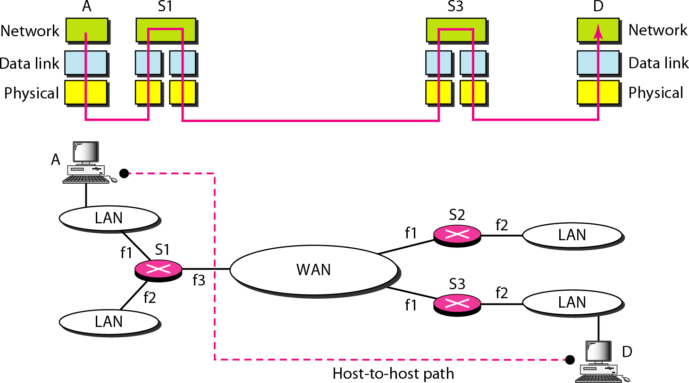
Figure 20.2 Network layer in an internetwork
20.4

Slide 64
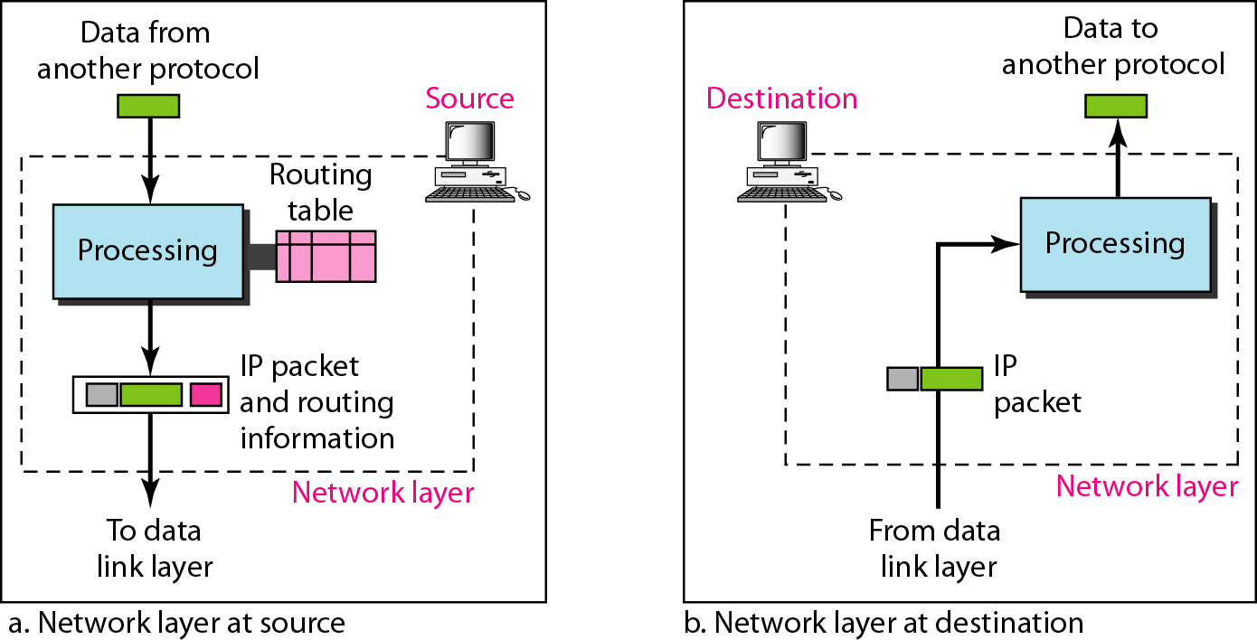
Figure 20.3 Network layer at the source, router, and destination
20.5

Slide 65
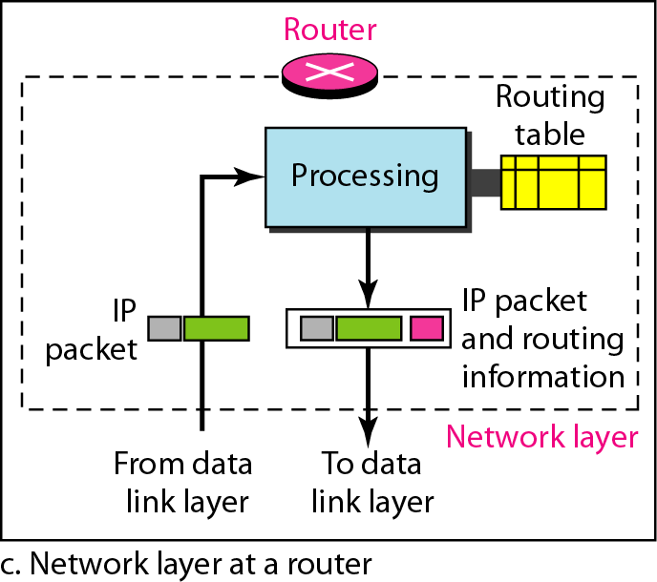
Figure 20.3 Network layer at the source, router, and destination (continued)
20.6

Slide 66
Note
Switching at the network layer in the Internet uses the datagram approach to packet switching.
20.7

Slide 67
Note
Communication at the network layer in the Internet is connectionless.
20.8

Slide 68
20-2 IPv4
The Internet Protocol version 4 (IPv4) is the delivery mechanism used by the TCP/IP protocols.
Topics discussed in this section:
Datagram Fragmentation Checksum Options
20.9

Slide 69
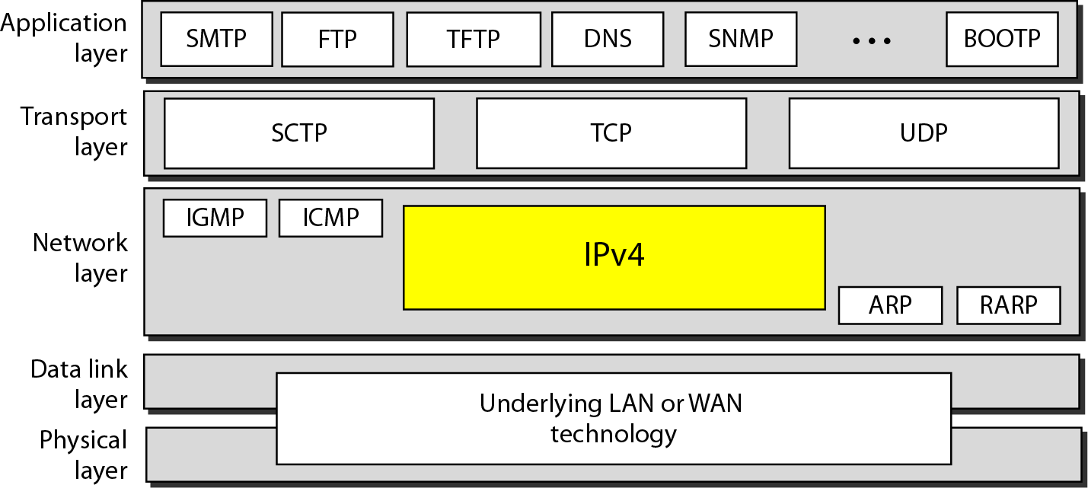
Figure 20.4 Position of IPv4 in TCP/IP protocol suite

Slide 70
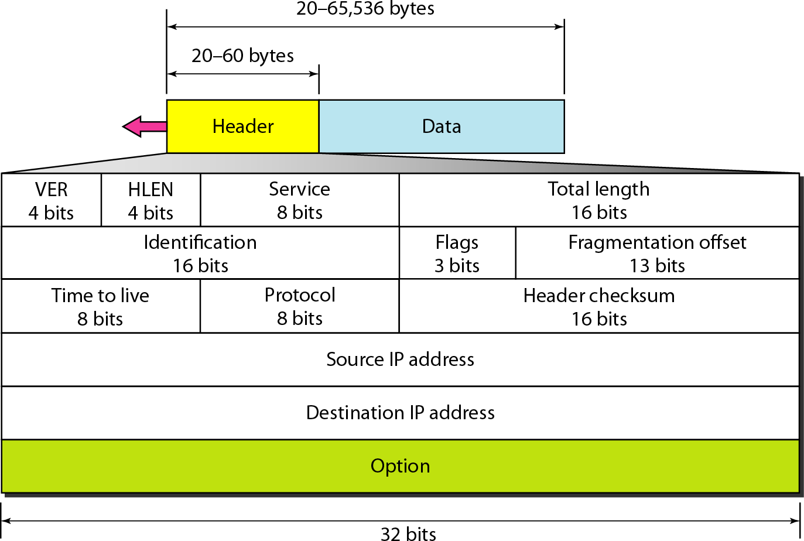
Figure 20.5 IPv4 datagram format

Slide 71
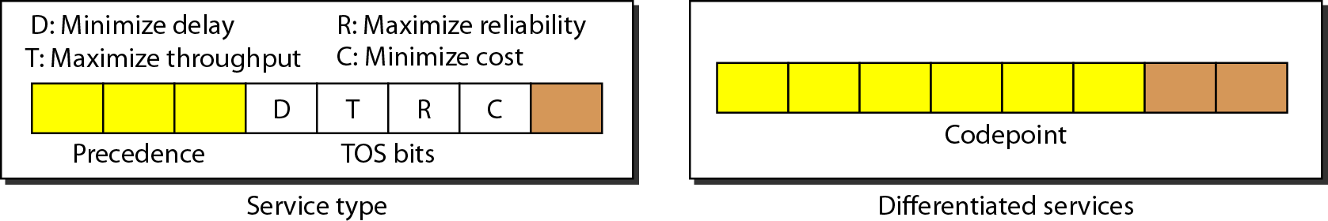
Figure 20.6 Service type or differentiated services

Slide 72
Note
The precedence subfield was part of version 4, but never used.

Slide 73
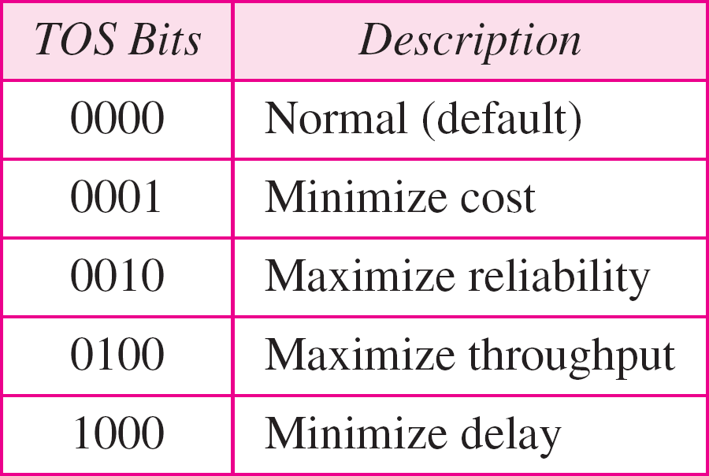
Table 20.1 Types of service

Slide 74
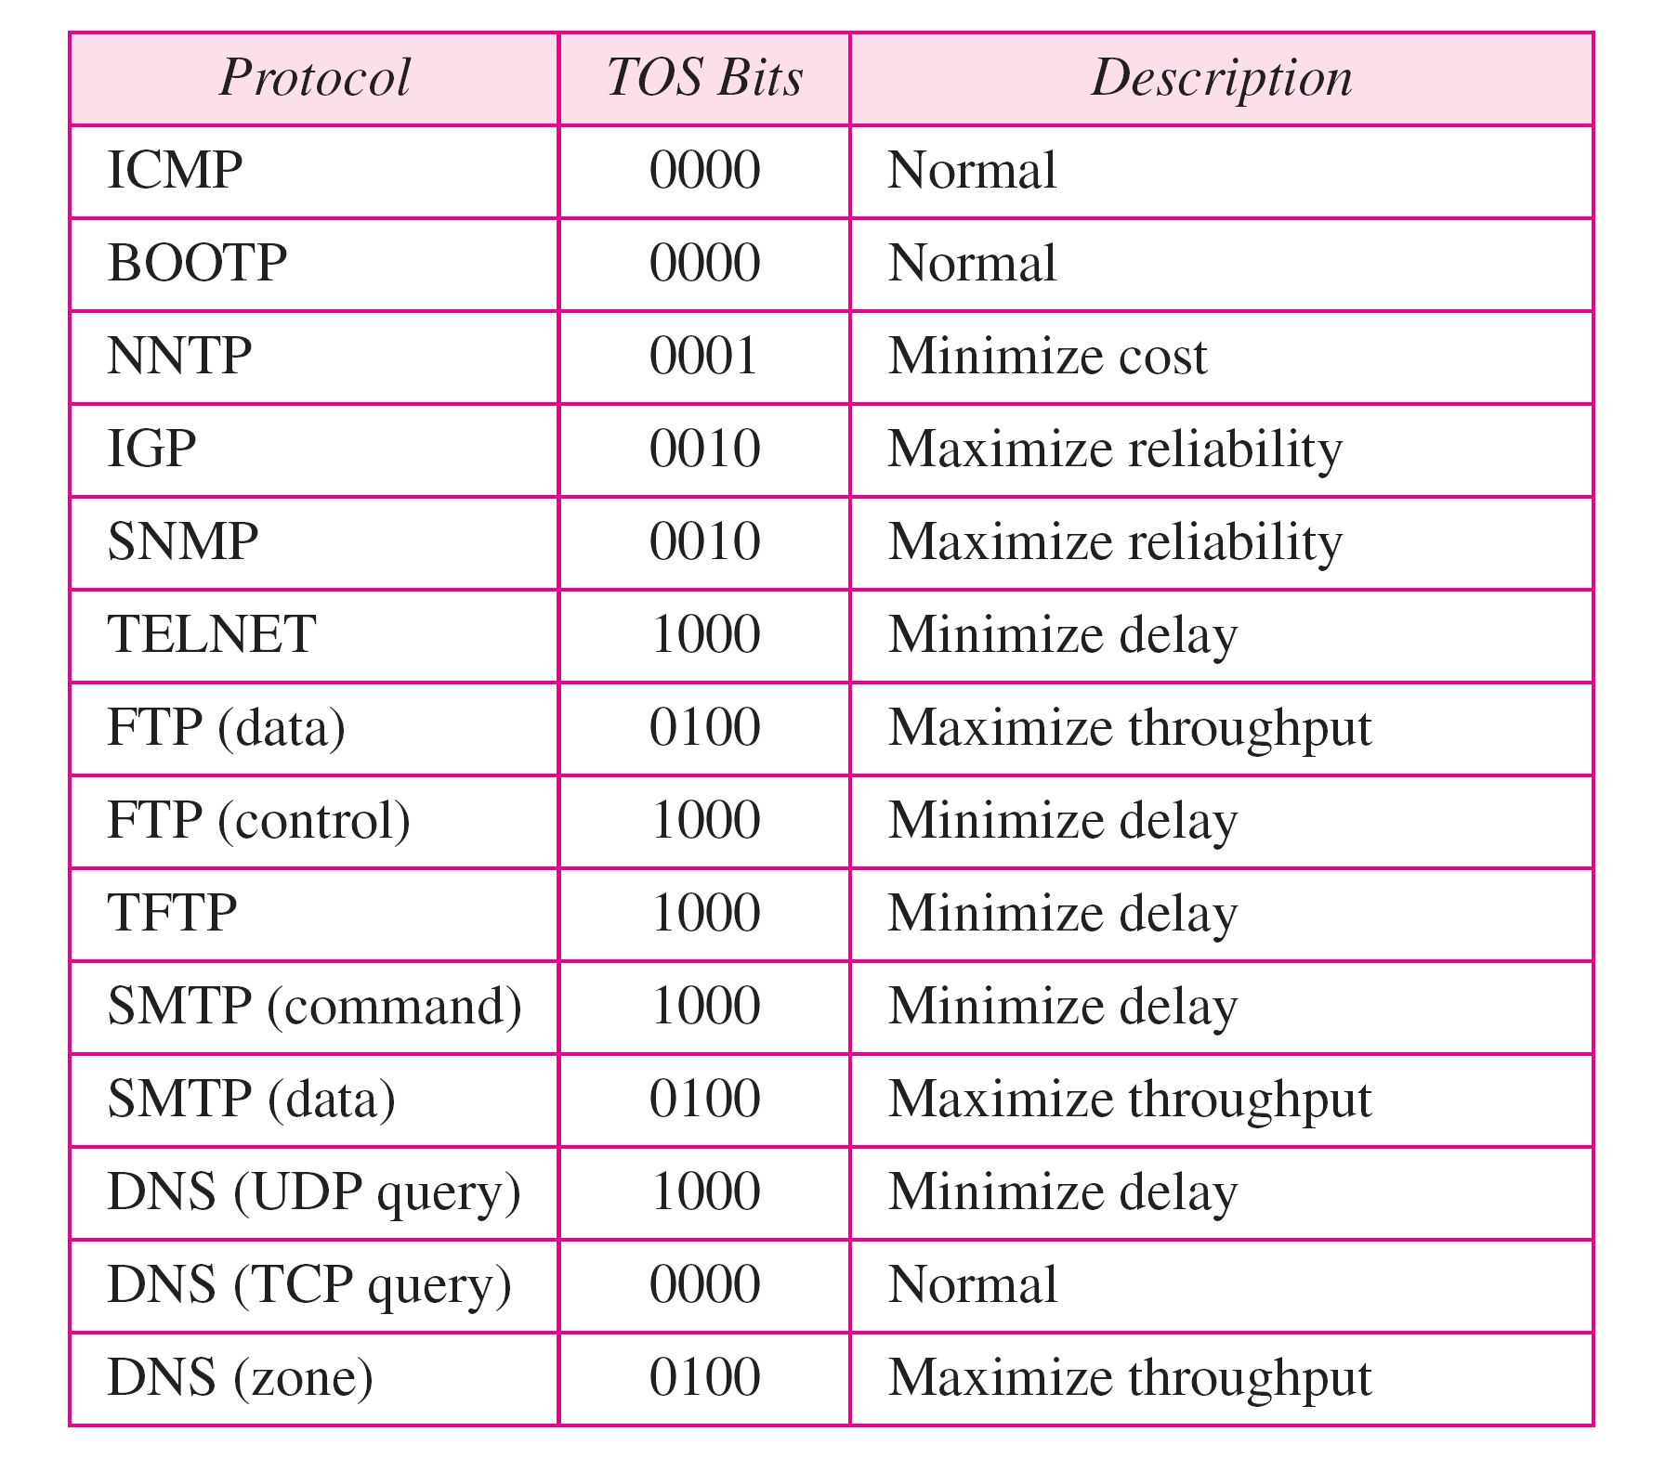
Table 20.2 Default types of service

Slide 75
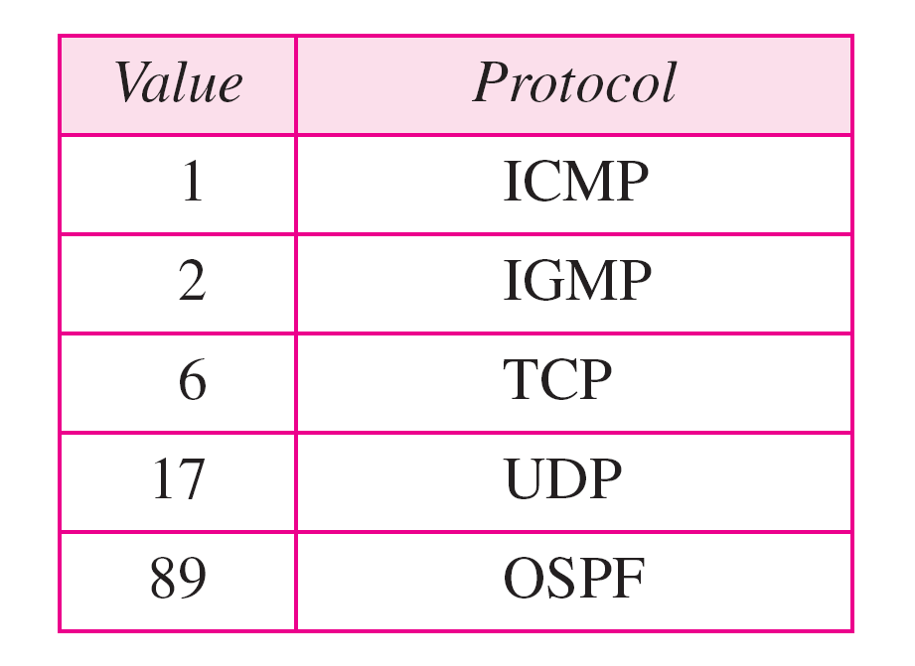
Table 20.3 Values for codepoints

Slide 76
Note
The total length field defines the total length of the datagram including the header.

Slide 77
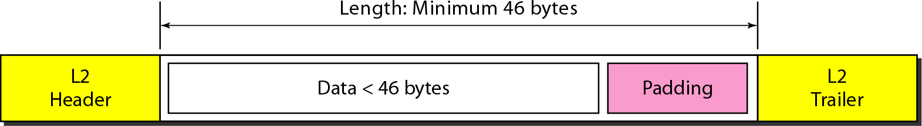
Figure 20.7 Encapsulation of a small datagram in an Ethernet frame

Slide 78
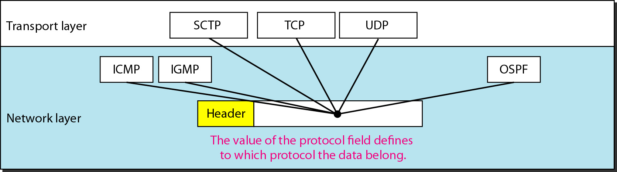
Figure 20.8 Protocol field and encapsulated data

Slide 79
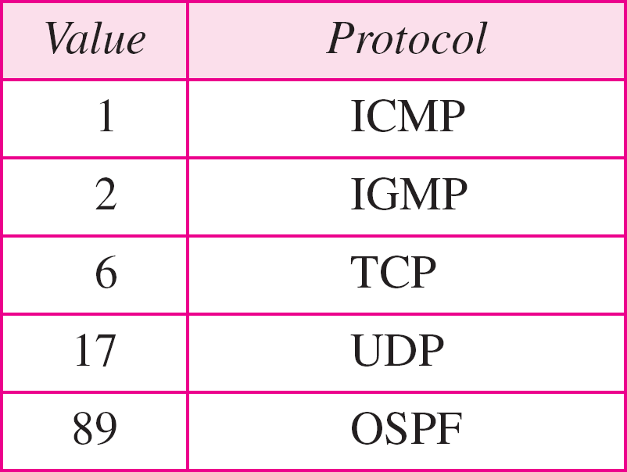
Table 20.4 Protocol values

Slide 80
Example 20.1
An IPv4 packet has arrived with the first 8 bits as shown:
01000010
The receiver discards the packet. Why?
Solution Thereisanerorinthispacket.The4leftmostbits(0100) showtheversion,whichiscorect.Thenext4bits(0010) showaninvalidheaderlength(2×4=8).Theminimum numberofbytesintheheadermustbe20.Thepackethas bencoruptedintransmission.

Slide 81
Example 20.2
In an IPv4 packet, the value of HLEN is 1000 in binary. How many bytes of options are being carried by this packet?
Solution
TheHLEN valueis8,whichmeansthetotalnumberof bytesintheheaderis8×4,or32bytes.Thefirst20bytes arethebaseheader,thenext12bytesaretheoptions.

Slide 82
Example 20.3
In an IPv4 packet, the value of HLEN is 5, and the value of the total length field is 0x0028. How many bytes of data are being carried by this packet?
Solution
TheHLEN valueis5,whichmeansthetotalnumberof bytesintheheaderis5×4,or20bytes(nooptions).The totallength is40 bytes,which meansthe packetis carying20bytesofdata(40−20).

Slide 83
Example 20.4
An IPv4 packet has arrived with the first few hexadecimal digits as shown.
0x45000028000100000102 . . .
How many hops can this packet travel before being dropped? The data belong to what upper-layer protocol?
Solution
Tofindthetime-to-livefield,weskip8bytes.Thetime-to- livefieldistheninthbyte,whichis01.Thismeansthe packetcantravelonlyonehop.Theprotocolfieldisthe nextbyte(02),whichmeansthatheupper-layerprotocol isIGMP.

Slide 84
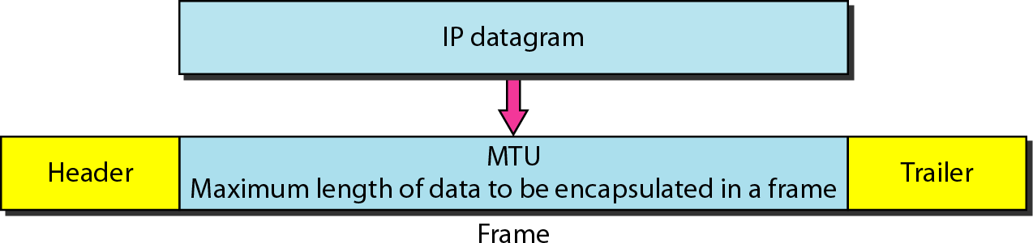
Figure 20.9 Maximum transfer unit (MTU)

Slide 85
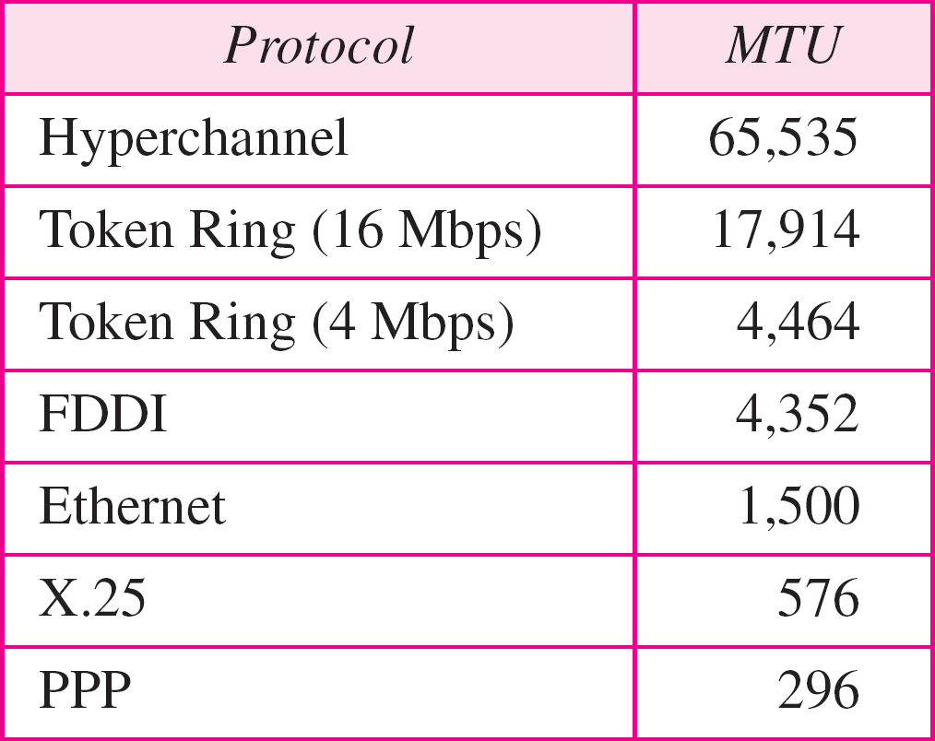
Table 20.5 MTUs for some networks

Slide 86

Figure 20.10 Flags used in fragmentation

Slide 87

Figure 20.11 Fragmentation example

Slide 88

Figure 20.12 Detailed fragmentation example

Slide 89
Example 20.5
A packet has arrived with an M bit value of 0. Is this the first fragment, the last fragment, or a middle fragment? Do we know if the packet was fragmented?
Solution
IftheM bitis0,itmeansthatthereareno more fragments;thefragmentisthelastone.However,we cannotsayiftheoriginalpacketwasfragmentedornot.A non-fragmentedpacketisconsideredthelastfragment.

Slide 90
Example 20.6
A packet has arrived with an M bit value of 1. Is this the first fragment, the last fragment, or a middle fragment? Do we know if the packet was fragmented?
Solution
IftheM bitis1,itmeansthathereisatleastonemore fragment.Thisfragmentcanbethefirstoneoramiddle one,butnothelastone.Wedon’tknowifitisthefirst oneoramiddleone;wenedmoreinformation(thevalue ofthefragmentationoffset).

Slide 91
Example 20.7
A packet has arrived with an M bit value of 1 and a fragmentation offset value of 0. Is this the first fragment, the last fragment, or a middle fragment?
Solution
BecausetheM bitis1,itiseitherthefirstfragmentora midleone.Becausetheoffsetvalueis0,itisthefirst fragment.

Slide 92
Example 20.8
A packet has arrived in which the offset value is 100. What is the number of the first byte? Do we know the number of the last byte?
Solution
To find the number of the first byte, we multiply the offset value by 8. This means that the first byte number is 800.
We cannot determine the number of the last byte unless we know the length.

Slide 93
Example 20.9
A packet has arrived in which the offset value is 100, the value of HLEN is 5, and the value of the total length field is 100. What are the numbers of the first byte and the last byte?
Solution
Thefirstbytenumberis100×8=800.Thetotalengthis 100bytes,andtheheaderlengthis20bytes(5×4),which meansthathereare80bytesinthisdatagram.Ifthefirst bytenumberis800,thelastbytenumbermustbe879.

Slide 94
Example 20.10
Figure 20.13 shows an example of a checksum calculation for an IPv4 header without options. The header is divided into 16-bit sections. All the sections are added and the sum is complemented. The result is inserted in the checksum field.

Slide 95

Figure 20.13 Example of checksum calculation in IPv4

Slide 96

Figure 20.14 Taxonomy of options in IPv4

Slide 97
20-3 IPv6
The network layer protocol in the TCP/IP protocol suite is currently IPv4. Although IPv4 is well designed, data communication has evolved since the inception of IPv4 in the 1970s. IPv4 has some deficiencies that make it unsuitable for the fast-growing Internet.
Topics discussed in this section:
Advantages Packet Format Extension Headers

Slide 98

Figure 20.15 IPv6 datagram header and payload

Slide 99

Figure 20.16 Format of an IPv6 datagram

Slide 100

Table 20.6 Next header codes for IPv6

Slide 101

Table 20.7 Priorities for congestion-controlled traffic

Slide 102

Table 20.8 Priorities for noncongestion-controlled traffic

Slide 103

Table 20.9 Comparison between IPv4 and IPv6 packet headers

Slide 104

Figure 20.17 Extension header types

Slide 105

Table 20.10 Comparison between IPv4 options and IPv6 extension headers

Slide 106
20-4 TRANSITIONFROM IPv4TOIPv6
Because of the huge number of systems on the Internet, the transition from IPv4 to IPv6 cannot happen suddenly. It takes a considerable amount of time before every system in the Internet can move from IPv4 to IPv6. The transition must be smooth to prevent any problems between IPv4 and IPv6 systems.
Topics discussed in this section:
Dual Stack Tunneling
Header Translation

Slide 107

Figure 20.18 Three transition strategies

Slide 108

Figure 20.19 Dual stack

Slide 109

Figure 20.20 Tunneling strategy

Slide 110

Figure 20.21 Header translation strategy

Slide 111

Table 20.11 Header translation

Slide 112

Chapter 21
Network Layer: Address Mapping, Error Reporting, and Multicasting
21.1
Copyright © The McGraw-Hill Companies, Inc. Permission required for reproduction or display.

Slide 113
21-1 ADDRESSMAPPING
The delivery of a packet to a host or a router requires two levels of addressing: logical and physical. We need to be able to map a logical address to its corresponding physical address and vice versa. This can be done by using either static or dynamic mapping.
Topics discussed in this section: Mapping Logical to Physical Address Mapping Physical to Logical Address
21.2

Slide 114

Figure 21.1 ARP operation
21.3

Slide 115

Figure 21.2 ARP packet
21.4

Slide 116

Figure 21.3 Encapsulation of ARP packet
21.5

Slide 117

Figure 21.4 Four cases using ARP
21.6

Slide 118
Note
An ARP request is broadcast; an ARP reply is unicast.
21.7

Slide 119
Example 21.1
A host with IP address 130.23.43.20 and physical address B2:34:55:10:22:10 has a packet to send to another host with IP address 130.23.43.25 and physical address A4:6E:F4:59:83:AB. The two hosts are on the same Ethernet network. Show the ARP request and reply packets encapsulated in Ethernet frames.
Solution
Figure 21.5 shows the ARP request and reply packets. Note that the ARP data field in this case is 28 bytes, and that the individual addresses do not fit in the 4-byte boundary. That is why we do not show the regular 4-byte boundaries for these addresses.
21.8

Slide 120

Figure 21.5 Example 21.1, an ARP request and reply
21.9

Slide 121

Figure 21.6 Proxy ARP

Slide 122

Figure 21.7 BOOTP client and server on the same and different networks

Slide 123
Note
DHCP provides static and dynamic address allocation that can be manual or automatic.

Slide 124
21-2 ICMP
The IP protocol has no error-reporting or error- correcting mechanism. The IP protocol also lacks a mechanism for host and management queries. The Internet Control Message Protocol (ICMP) has been designed to compensate for the above two deficiencies. It is a companion to the IP protocol.
Topics discussed in this section:
Types of Messages Message Format
Error Reporting and Query Debugging Tools

Slide 125

Figure 21.8 General format of ICMP messages

Slide 126
Note
ICMP always reports error messages to the original source.

Slide 127

Figure 21.9 Error-reporting messages

Slide 128
Note
Important points about ICMP error messages:
❏ No ICMP error message will be generated in response to a datagram carrying an ICMP error
message.
❏ No ICMP error message will be generated for a fragmented datagram that is not the first fragment.
❏ No ICMP error message will be generated for a datagram having a multicast address.
❏ No ICMP error message will be generated for a datagram having a special address such as
127.0.0.0 or 0.0.0.0.

Slide 129

Figure 21.10 Contents of data field for the error messages

Slide 130

Figure 21.11 Redirection concept

Slide 131

Figure 21.12 Query messages

Slide 132

Figure 21.13 Encapsulation of ICMP query messages

Slide 133
Example 21.2
Figure 21.14 shows an example of checksum calculation for a simple echo-request message. We randomly chose the identifier to be 1 and the sequence number to be 9. The message is divided into 16-bit (2-byte) words. The words are added and the sum is complemented. Now the sender can put this value in the checksum field.

Slide 134

Figure 21.14 Example of checksum calculation

Slide 135
Example 21.3
We use the ping program to test the server fhda.edu. The result is shown on the next slide. The ping program sends messages with sequence numbers starting from 0. For each probe it gives us the RTT time. The TTL (time to live) field in the IP datagram that encapsulates an ICMP message has been set to 62. At the beginning, ping defines the number of data bytes as 56 and the total number of bytes as 84. It is obvious that if we add 8 bytes of ICMP header and 20 bytes of IP header to 56, the result is 84. However, note that in each probe ping defines the number of bytes as 64. This is the total number of bytes in the ICMP packet (56 + 8).

Slide 136




Example 21.3 (continued)

Slide 137

Figure 21.15 The traceroute program operation

Slide 138

Example 21.4
We use the traceroute program to find the route from the computer voyager.deanza.edu to the server fhda.edu. The following shows the result:
The unnumbered line after the command shows that the destination is 153.18.8.1. The packet contains 38 bytes: 20 bytes of IP header, 8 bytes of UDP header, and 10 bytes of application data. The application data are used by traceroute to keep track of the packets.

Slide 139
Example 21.4 (continued)
The first line shows the first router visited. The router is named Dcore.fhda.edu with IP address 153.18.31.254. The first round-trip time was 0.995 ms, the second was 0.899 ms, and the third was 0.878 ms. The second line shows the second router visited. The router is named Dbackup.fhda.edu with IP address 153.18.251.4. The three round-trip times are also shown. The third line shows the destination host. We know that this is the destination host because there are no more lines. The destination host is the server fhda.edu, but it is named tiptoe.fhda.edu with the IP address 153.18.8.1. The three round-trip times are also shown.

Slide 140
Example 21.5
In this example, we trace a longer route, the route to xerox.com (see next slide). Here there are 17 hops between source and destination. Note that some round- trip times look unusual. It could be that a router was too busy to process the packet immediately.

Slide 141

Example 21.5 (continued)

Slide 142
21-3 IGMP
The IP protocol can be involved in two types of communication: unicasting and multicasting. The Internet Group Management Protocol (IGMP) is one of the necessary, but not sufficient, protocols that is involved in multicasting. IGMP is a companion to the IP protocol.
Topics discussed in this section:
Group Management
IGMP Messages and IGMP Operation Encapsulation
Netstat Utility

Slide 143

Figure 21.16 IGMP message types

Slide 144

Figure 21.17 IGMP message format

Slide 145

Table 21.1 IGMP type field

Slide 146

Figure 21.18 IGMP operation

Slide 147
Note
In IGMP, a membership report is sent twice, one after the other.

Slide 148
Note
The general query message does not define a particular group.

Slide 149
Example 21.6
Imagine there are three hosts in a network, as shown in Figure 21.19. A query message was received at time 0; the random delay time (in tenths of seconds) for each group is shown next to the group address. Show the sequence of report messages.
Solution
The events occur in this sequence:
a. Time 12: The timer for 228.42.0.0 in host A expires, and a membership report is sent, which is received by the router and every host including host B which
cancels its timer for 228.42.0.0.

Slide 150
Example 21.6 (continued)
Time 30: The timer for 225.14.0.0 in host A expires, and a membership report is sent which is received by the router and every host including host C which cancels its timer for 225.14.0.0.
Time 50: The timer for 238.71.0.0 in host B expires, and a membership report is sent, which is received by the router and every host.
Time 70: The timer for 230.43.0.0 in host C expires, and a membership report is sent, which is received by the router and every host including host A which
cancels its timer for 230.43.0.0.

Slide 151

Figure 21.19 Example 21.6

Slide 152

Figure 21.20 Encapsulation of IGMP packet

Slide 153
Note
The IP packet that carries an IGMP packet has a value of 1 in its TTL field.

Slide 154

Table 21.2 Destination IP addresses

Slide 155

Figure 21.21 Mapping class D to Ethernet physical address

Slide 156
Note
An Ethernet multicast physical address is in the range
01:00:5E:00:00:00 to 01:00:5E:7F:FF:FF.

Slide 157
Example 21.7
Change the multicast IP address 230.43.14.7 to an Ethernet multicast physical address.
Solution
We can do this in two steps:
a. We write the rightmost 23 bits of the IP address in hexadecimal. This can be done by changing the rightmost 3 bytes to hexadecimal and then subtracting 8 from the leftmost digit if it is greater than or equal to
8. In our example, the result is 2B:0E:07.

Slide 158

Example 21.7 (continued)
b. We add the result of part a to the starting Ethernet multicast address, which is 01:00:5E:00:00:00. The result is

Slide 159

Example 21.8
Change the multicast IP address 238.212.24.9 to an Ethernet multicast address.
Solution
The rightmost 3 bytes in hexadecimal is D4:18:09. We need to subtract 8 from the leftmost digit, resulting in 54:18:09.
We add the result of part a to the Ethernet multicast starting address. The result is

Slide 160

Figure 21.22 Tunneling

Slide 161
Example 21.9
We use netstat (see next slide) with three options: -n, -r, and -a. The -n option gives the numeric versions of IP addresses, the -r option gives the routing table, and the -a option gives all addresses (unicast and multicast). Note that we show only the fields relative to our discussion. “Gateway” defines the router, “Iface” defines the interface.
Note that the multicast address is shown in color. Any packet with a multicast address from 224.0.0.0 to 239.255.255.255 is masked and delivered to the Ethernet interface.

Slide 162

Example 21.9 (continued)

Slide 163
21-4 ICMPv6
We discussed IPv6 in Chapter 20. Another protocol that has been modified in version 6 of the TCP/IP protocol suite is ICMP (ICMPv6). This new version follows the same strategy and purposes of version 4.
Topics discussed in this section:
Error Reporting Query

Slide 164

Figure 21.23 Comparison of network layers in version 4 and version 6

Slide 165

Table 21.3 Comparison of error-reporting messages in ICMPv4 and ICMPv6

Slide 166

Table 21.4 Comparison of query messages in ICMPv4 and ICMPv6

Slide 167
Chapter 22 Network Layer:
Delivery, Forwarding, and Routing
22.1
Copyright © The McGraw-Hill Companies, Inc. Permission required for reproduction or display.

Slide 168
22-1 DELIVERY
The network layer supervises the handling of the packets by the underlying physical networks. We define this handling as the delivery of a packet.
Topics discussed in this section:
Direct Versus Indirect Delivery
22.2

Slide 169

Figure 22.1 Direct and indirect delivery
22.3

Slide 170
22-2 FORWARDING
Forwarding means to place the packet in its route to its destination. Forwarding requires a host or a router to have a routing table. When a host has a packet to send or when a router has received a packet to be forwarded, it looks at this table to find the route to the final destination.
Topics discussed in this section: Forwarding Techniques Forwarding Process
Routing Table
22.4

Slide 171

Figure 22.2 Route method versus next-hop method
22.5

Slide 172

Figure 22.3 Host-specific versus network-specific method
22.6

Slide 173

Figure 22.4 Default method
22.7

Slide 174

Figure 22.5 Simplified forwarding module in classless address
22.8

Slide 175
Note
In classless addressing, we need at least four columns in a routing table.
22.9

Slide 176
Example 22.1
Make a routing table for router R1, using the configuration in Figure 22.6.
Solution
Table 22.1 shows the corresponding table.

Slide 177

Figure 22.6 Configuration for Example 22.1

Slide 178

Table 22.1 Routing table for router R1 in Figure 22.6

Slide 179
Example 22.2
Show the forwarding process if a packet arrives at R1 in Figure 22.6 with the destination address 180.70.65.140.
Solution
The router performs the following steps:
The first mask (/26) is applied to the destination address. The result is 180.70.65.128, which does not match the corresponding network address.
The second mask (/25) is applied to the destination address. The result is 180.70.65.128, which matches the corresponding network address. The next-hop address and the interface number m0 are passed to ARP for further processing.

Slide 180
Example 22.3
Show the forwarding process if a packet arrives at R1 in Figure 22.6 with the destination address 201.4.22.35.
Solution
The router performs the following steps:
The first mask (/26) is applied to the destination address. The result is 201.4.22.0, which does not match the corresponding network address.
The second mask (/25) is applied to the destination address. The result is 201.4.22.0, which does not match the corresponding network address (row 2).

Slide 181
Example 22.3 (continued)
3. The third mask (/24) is applied to the destination address. The result is 201.4.22.0, which matches the corresponding network address. The destination address of the packet and the interface number m3 are passed to ARP.

Slide 182
Example 22.4
Show the forwarding process if a packet arrives at R1 in Figure 22.6 with the destination address 18.24.32.78.
Solution
This time all masks are applied, one by one, to the destination address, but no matching network address is found. When it reaches the end of the table, the module gives the next-hop address 180.70.65.200 and interface number m2 to ARP. This is probably an outgoing package that needs to be sent, via the default router, to someplace else in the Internet.

Slide 183

Figure 22.7 Address aggregation

Slide 184

Figure 22.8 Longest mask matching

Slide 185
Example 22.5
As an example of hierarchical routing, let us consider Figure 22.9. A regional ISP is granted 16,384 addresses starting from 120.14.64.0. The regional ISP has decided to divide this block into four subblocks, each with 4096 addresses. Three of these subblocks are assigned to three local ISPs; the second subblock is reserved for future use. Note that the mask for each block is /20 because the original block with mask /18 is divided into 4 blocks.
The first local ISP has divided its assigned subblock into 8 smaller blocks and assigned each to a small ISP. Each small ISP provides services to 128 households, each using four addresses.

Slide 186
Example 22.5 (continued)
The second local ISP has divided its block into 4 blocks
and has assigned the addresses to four large
organizations.
The third local ISP has divided its block into 16 blocks and assigned each block to a small organization. Each small organization has 256 addresses, and the mask is / 24.
There is a sense of hierarchy in this configuration. All routers in the Internet send a packet with destination address 120.14.64.0 to 120.14.127.255 to the regional ISP.

Slide 187

Figure 22.9 Hierarchical routing with ISPs

Slide 188

Figure 22.10 Common fields in a routing table

Slide 189
Example 22.6
One utility that can be used to find the contents of a routing table for a host or router is netstat in UNIX or LINUX. The next slide shows the list of the contents of a default server. We have used two options, r and n. The option r indicates that we are interested in the routing table, and the option n indicates that we are looking for numeric addresses. Note that this is a routing table for a host, not a router. Although we discussed the routing table for a router throughout the chapter, a host also needs a routing table.

Slide 190

Example 22.6 (continued)
The destination column here defines the network address. The term gateway used by UNIX is synonymous with router. This column actually defines the address of the next hop. The value 0.0.0.0 shows that the delivery is direct. The last entry has a flag of G, which means that the destination can be reached through a router (default router). The Iface defines the interface.

Slide 191

Example 22.6 (continued)
More information about the IP address and physical address of the server can be found by using the ifconfig command on the given interface (eth0).

Slide 192

Figure 22.11 Configuration of the server for Example 22.6

Slide 193
22-3 UNICASTROUTINGPROTOCOLS
A routing table can be either static or dynamic. A static table is one with manual entries. A dynamic table is one that is updated automatically when there is a change somewhere in the Internet. A routing protocol is a combination of rules and procedures that lets routers in the Internet inform each other of changes.
Topics discussed in this section:
Optimization
Intra- and Interdomain Routing Distance Vector Routing and RIP Link State Routing and OSPF Path Vector Routing and BGP

Slide 194

Figure 22.12 Autonomous systems

Slide 195

Figure 22.13 Popular routing protocols

Slide 196

Figure 22.14 Distance vector routing tables

Slide 197

Figure 22.15 Initialization of tables in distance vector routing

Slide 198
Note
In distance vector routing, each node shares its routing table with its immediate neighbors periodically and when there is a change.

Slide 199

Figure 22.16 Updating in distance vector routing

Slide 200

Figure 22.17 Two-node instability

Slide 201

Figure 22.18 Three-node instability

Slide 202

Figure 22.19 Example of a domain using RIP

Slide 203

Figure 22.20 Concept of link state routing

Slide 204

Figure 22.21 Link state knowledge

Slide 205

Figure 22.22 Dijkstra algorithm

Slide 206

Figure 22.23 Example of formation of shortest path tree

Slide 207

Table 22.2 Routing table for node A

Slide 208

Figure 22.24 Areas in an autonomous system

Slide 209

Figure 22.25 Types of links

Slide 210

Figure 22.26 Point-to-point link

Slide 211

Figure 22.27 Transient link

Slide 212

Figure 22.28 Stub link

Slide 213

Figure 22.29 Example of an AS and its graphical representation in OSPF

Slide 214

Figure 22.30 Initial routing tables in path vector routing

Slide 215

Figure 22.31 Stabilized tables for three autonomous systems

Slide 216

Figure 22.32 Internal and external BGP sessions

Slide 217
22-4 MULTICASTROUTINGPROTOCOLS
In this section, we discuss multicasting and multicast routing protocols.
Topics discussed in this section: Unicast, Multicast, and Broadcast Applications
Multicast Routing Routing Protocols

Slide 218

Figure 22.33 Unicasting

Slide 219
Note
In unicasting, the router forwards the received packet through
only one of its interfaces.

Slide 220

Figure 22.34 Multicasting

Slide 221
Note
In multicasting, the router may forward the received packet through several of its interfaces.

Slide 222

Figure 22.35 Multicasting versus multiple unicasting

Slide 223
Note
Emulation of multicasting through multiple unicasting is not efficient and may create long delays, particularly with a large group.

Slide 224
Note
In unicast routing, each router in the domain has a table that defines
a shortest path tree to possible destinations.

Slide 225

Figure 22.36 Shortest path tree in unicast routing

Slide 226
Note
In multicast routing, each involved router needs to construct
a shortest path tree for each group.

Slide 227

Figure 22.37 Source-based tree approach

Slide 228
Note
In the source-based tree approach, each router needs to have one shortest path tree for each group.

Slide 229

Figure 22.38 Group-shared tree approach

Slide 230
Note
In the group-shared tree approach, only the core router, which has a shortest path tree for each group, is involved in multicasting.

Slide 231

Figure 22.39 Taxonomy of common multicast protocols

Slide 232
Note
Multicast link state routing uses the source-based tree approach.

Slide 233
Note
Flooding broadcasts packets, but creates loops in the systems.

Slide 234
Note
RPF eliminates the loop in the flooding process.

Slide 235

Figure 22.40 Reverse path forwarding (RPF)

Slide 236

Figure 22.41 Problem with RPF

Slide 237

Figure 22.42 RPF Versus RPB

Slide 238
Note
RPB creates a shortest path broadcast tree from the source to each destination.
It guarantees that each destination receives one and only one copy
of the packet.

Slide 239

Figure 22.43 RPF, RPB, and RPM

Slide 240
Note
RPM adds pruning and grafting to RPB to create a multicast shortest
path tree that supports dynamic membership changes.

Slide 241

Figure 22.44 Group-shared tree with rendezvous router

Slide 242

Figure 22.45 Sending a multicast packet to the rendezvous router

Slide 243
Note
In CBT, the source sends the multicast packet (encapsulated in a unicast packet) to the core router. The core router decapsulates the packet and forwards it to all interested interfaces.

Slide 244
Note
PIM-DM is used in a dense multicast environment, such as a LAN.

Slide 245
Note
PIM-DM uses RPF and pruning and grafting strategies to handle multicasting.
However, it is independent of the underlying unicast protocol.

Slide 246
Note
PIM-SM is used in a sparse multicast environment such as a WAN.

Slide 247
Note
PIM-SM is similar to CBT but uses a simpler procedure.

Slide 248

Figure 22.46 Logical tunneling

Slide 249

Figure 22.47 MBONE

